Slide 1
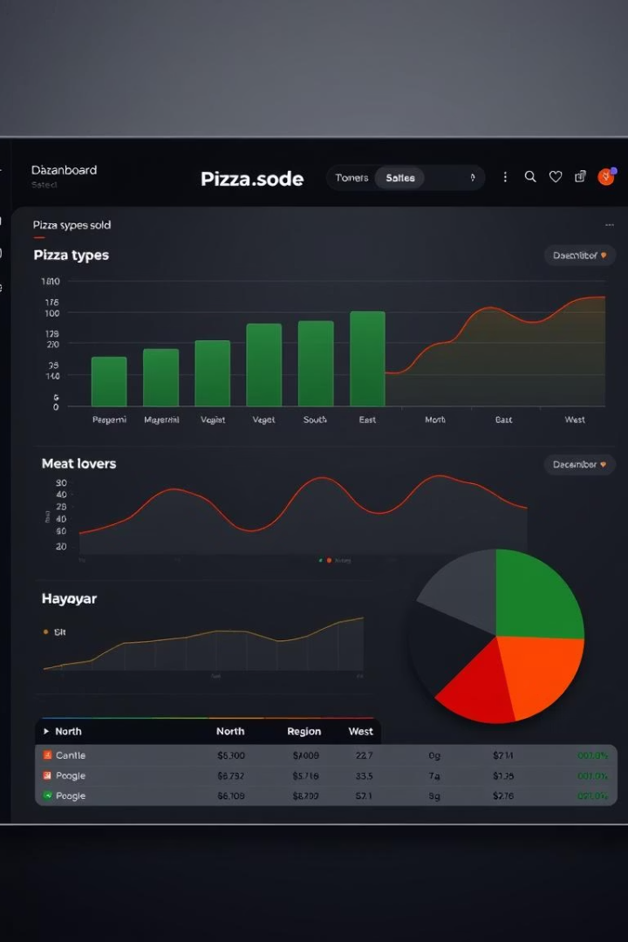

Pizza Sales and Performance Analytics
Welcome to our deep dive into pizza sales and performance. This presentation will provide data-driven insights to optimise our operations, refine our menu, and enhance marketing strategies. We've leveraged SQL analytics on comprehensive datasets including orders, pizzas, and pizza types, structured in a relational format.
Our analytical approach covers various dimensions, from overall revenue and quantity sold to specific insights based on pizza size, category, time of order, and even individual ingredients. These findings are designed to empower smarter business decisions, ensuring sustained growth and improved customer satisfaction.
by GiGi Molki

Slide 2
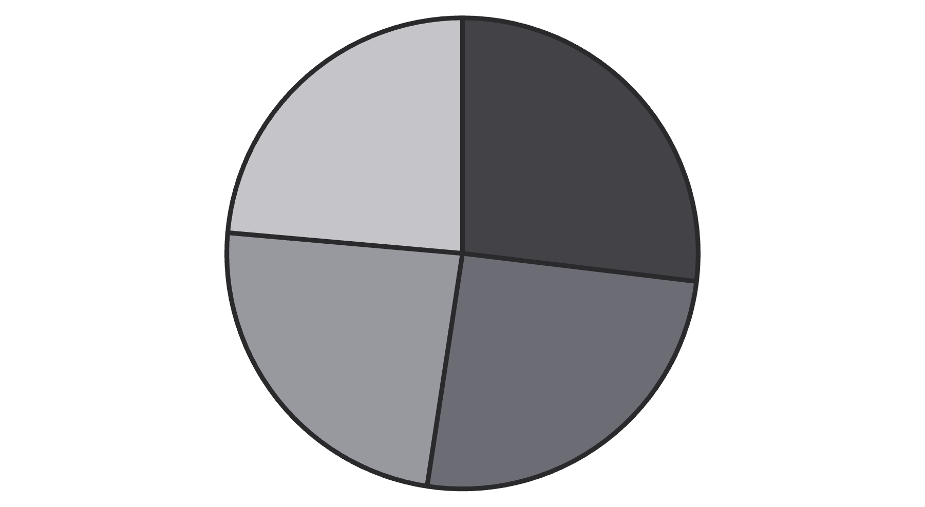
Revenue Performance Highlights
Classic
Supreme
Chicken
Veggie
Our total revenue stands impressively at ₹817,860.05. A significant portion of this comes from our top performers, with the Thai Chicken Pizza leading the charge at ₹43,434.25. The top 5 pizzas collectively contribute approximately 24% of our total revenue, highlighting their critical role.
In terms of size, large pizzas are a powerhouse, generating a substantial 46% of total revenue. Examining our category split, Classic pizzas lead with 26.9% of revenue, closely followed by Supreme (25.5%), Chicken (24%), and Veggie (23.6%). These figures underscore the importance of understanding specific product performance for strategic planning.

Slide 3
Top Performing Pizzas
1
Thai Chicken Pizza
2
BBQ Chicken Pizza
3
California Chicken Pizza
₹43,434.25 - A rich-flavored, high-demand option.
₹42,768.00 - Consistently strong performer, particularly popular for its savory profile.
₹41,409.50 - Another chicken-based favourite, appealing to a broad customer base.
4
Classic Deluxe Pizza
5
Spicy Italian Pizza
₹38,180.50 - A traditional choice with enduring appeal.
₹34,831.25 - Stands out among meat options with its distinct, bold taste.
Our analysis reveals a clear pattern among our top 5 pizzas: they are either rich-flavored or chicken-based. This insight is crucial for our menu strategy. These high performers are ideal candidates for upselling, integrating into combo deals, and receiving premium placement on our menu and marketing materials.
Our strategic focus should be to leverage these popular choices for targeted promotions and bundles to boost repeat purchases. Understanding what drives their success allows us to replicate elements of their appeal across our broader product range.

Slide 4
Low Performers & Opportunities
Brie Carre Pizza
Niche Flavours
Action Points
The lowest revenue generator at ₹11,588.50, suggesting a niche appeal or lack of customer familiarity.
Several bottom-tier pizzas fall into categories with less familiar or highly specialised flavour profiles, potentially limiting their market reach.
Immediate audit of visibility and placement on the menu and promotional materials. Consider rebranding, bundling with popular items, or seasonal promotions to test market response. Establish a clear tracking system to measure improvement post-intervention.
While our top pizzas soar, it's essential to address those at the bottom tier. The Brie Carre Pizza, with the lowest revenue at ₹11,588.50, exemplifies a category of pizzas that may be niche or less familiar to our customer base. These items often feature unique or less conventional ingredients, which, while appealing to some, may deter others.
Our action points include auditing their current visibility and placement, exploring rebranding or bundling strategies to enhance their appeal, or promoting them seasonally to gauge interest. Crucially, we must track their performance closely after implementing these interventions to inform future menu decisions.

Slide 5




Time-Based Revenue Trends
Best Months
May, July, and November consistently show the highest revenue and order volumes, indicating peak periods for promotions.
Best Day
Friday emerges as our strongest day for both order volume and revenue, a prime target for weekend kick-off campaigns.
Highest Avg. Order Value
Saturdays record the highest average order value, likely due to family or group purchases, presenting an opportunity for large-format bundles.
Peak Hours
The 12–1 PM and 5–7 PM windows are critical, representing our busiest periods for order intake and delivery.
Understanding our time-based revenue trends is crucial for optimising operations. Our analysis reveals that May, July, and November are consistently our best months, while Fridays lead in daily orders and revenue. Saturdays, however, show the highest average order value, suggesting larger group or family purchases.
The peak hours from 12–1 PM and 5–7 PM are particularly significant. This data has direct implications for staff scheduling, promotional timing, and delivery optimisation. By aligning our resources and marketing efforts with these peak periods, we can maximise efficiency and capture more sales.

Slide 6
Ingredient-Level Insights
Top Ingredients
Customer Favorites
High Margin
Mozzarella: The foundational cheese for most pizzas.
Red Onions: Adds a sharp, fresh bite.
Gouda: Offers a distinctive, rich flavour.
Garlic: A flavour enhancer across many popular options.
Red Peppers: Contributes sweetness and colour.
Romano: A pungent, salty hard cheese for flavour depth.
Tomatoes: Key for sauces and fresh toppings.
Pepperoni: A classic, highly requested topping.
Italian Sausage: A premium meat topping with good profit margins.
Delving into ingredient-level insights provides a granular view of what drives taste and sales. Mozzarella, garlic, and tomatoes are consistently our top-performing ingredients, forming the backbone of many popular pizzas. Red onions, red peppers, and pepperoni stand out as consistent customer favourites, often requested for their familiar and appealing flavours.
Furthermore, ingredients like Gouda, Romano, and Italian Sausage offer high-profit margins. Our menu strategy should therefore focus on designing pizzas around these high-performing ingredients, considering premium bundles with specialty toppings, and exploring seasonal rotations that leverage top-margin ingredients to maximise profitability.

Slide 7








Order Size & Category Insights
Large Pizzas
Classic Category
Generate 46% of total revenue, confirming their significant impact on overall sales performance.
Accounts for the highest volume of pizzas sold, indicating broad appeal and consistent demand.
High-Value Order Peaks
Chicken Category
These orders consistently peak around traditional lunch and dinner times, aligning with our busiest operational periods.
Boasts the highest revenue per order, suggesting customers often choose higher-priced or more elaborate chicken options.
Understanding what, how much, and when customers buy is pivotal for optimizing our sales strategy. The data clearly shows that large-sized pizzas are a significant revenue driver, contributing 46% of our total revenue. While the Classic category leads in sales volume, the Chicken category impressively generates the highest revenue per order.
Furthermore, high-value orders consistently peak around lunch and dinner times. Our strategic focus should therefore include actively pushing large-size upgrades, incentivising weekday large orders, and crafting premium bundles centered around our popular Chicken and Classic pizzas to capitalise on these trends.

Slide 8
Key Business Recommendations
10
2
Focus on Top Pizzas
Optimise Peak Periods
Double down on the top 10 pizzas by revenue and volume through enhanced marketing and premium placement.
Utilise identified peak hours and days for targeted promotional campaigns and resource allocation.
5
4
Evaluate Bottom Pizzas
Develop Smart Bundles
Consider retiring or repositioning the bottom 5 pizzas based on their performance and potential for improvement.
Launch intelligent bundles based on category, size, and timing to maximise average order value.
To conclude, our data-driven insights provide clear pathways for strategic growth. Firstly, we must double down on our top 10 pizzas, enhancing their visibility and promotional efforts to maximise their revenue and volume contributions. Secondly, leveraging our understanding of peak hours and days allows for more effective staff scheduling and targeted promotional campaigns.
Thirdly, a critical evaluation of our bottom 5 pizzas is necessary. This may involve either strategic repositioning or, if necessary, retiring them from the menu. Finally, the development of smart bundles, combining categories, sizes, and capitalising on specific timings, will be key to increasing average order value and driving overall profitability. Implementing these recommendations will be crucial for our sustained success.

